Slide 1


Slide 2

The best practices on journal
validation and finding

Slide 3

SCIENTIFIC REVIEW PROCESS
Completion of research
Preparation of manuscript
Submission of manuscript
Assignment and review
Decision
Rejection
Revision
Resubmission
Re-review
decision
Acceptance
PUBLICATION

Slide 4




How to Identify Validity and Quality of Scientific Journals

Slide 5

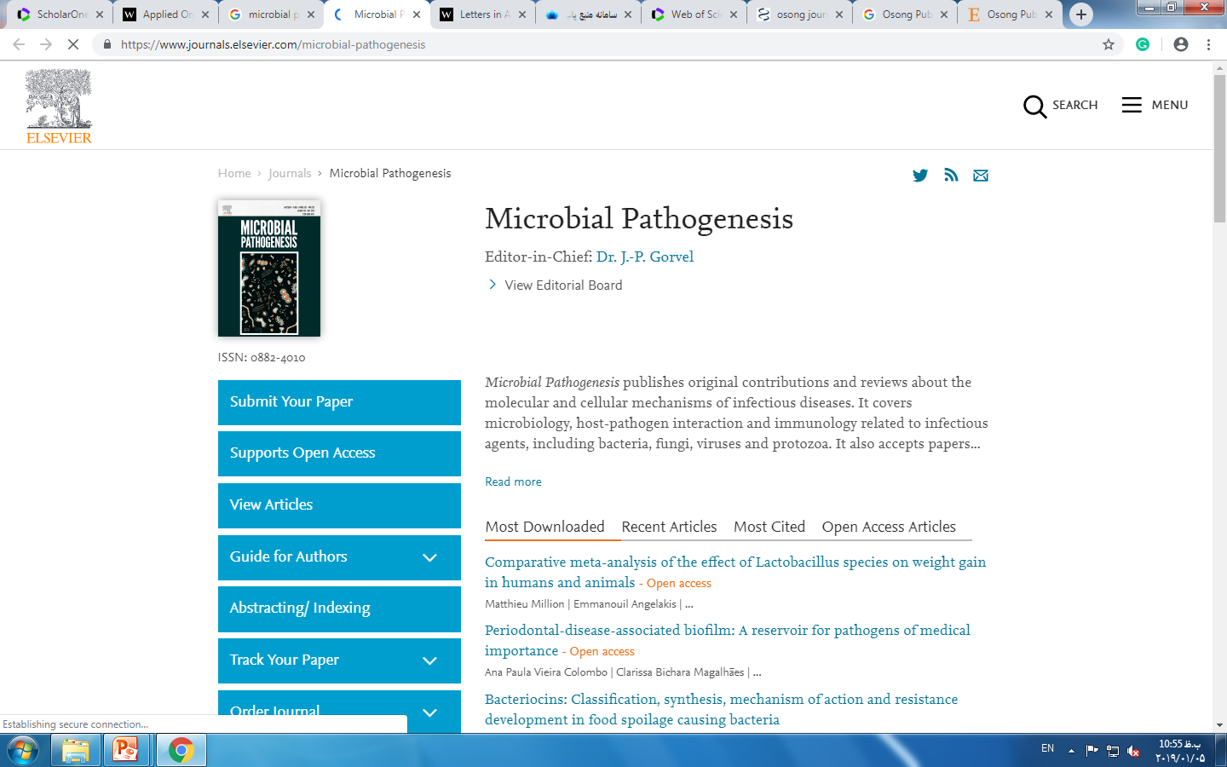
1. Check the journal's reputation and webpage

Slide 6
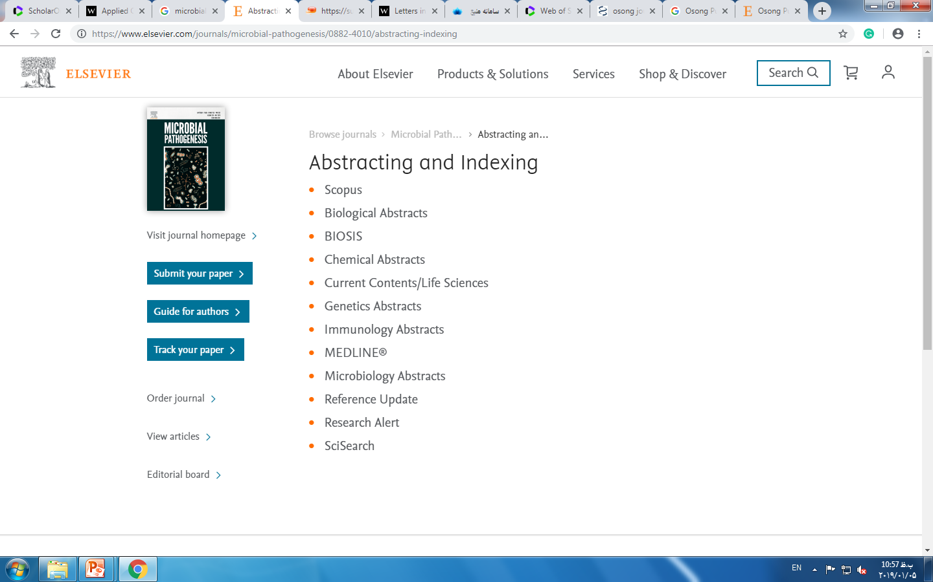

Slide 7
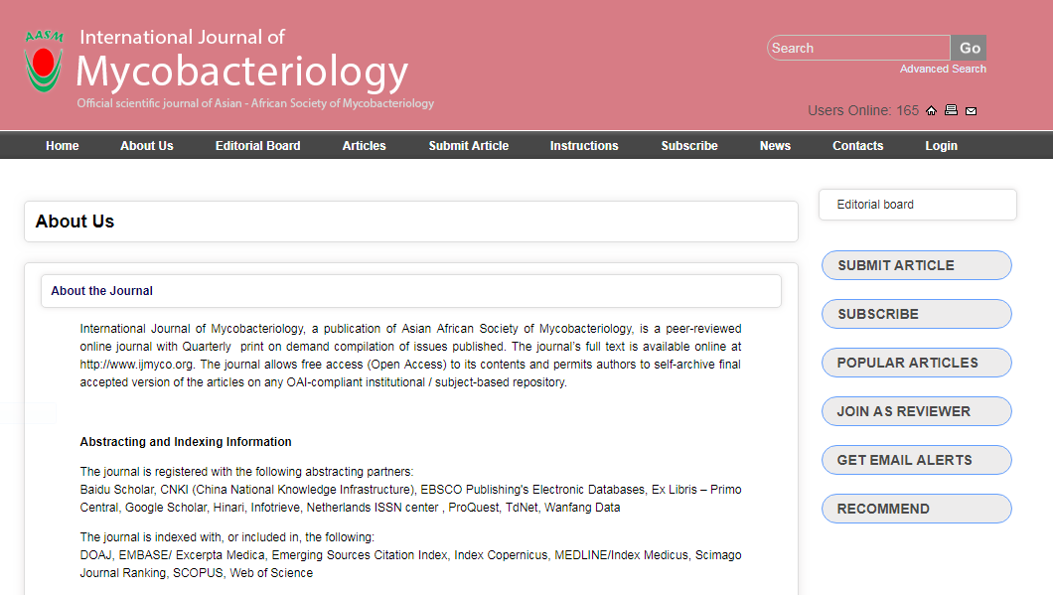

Slide 8
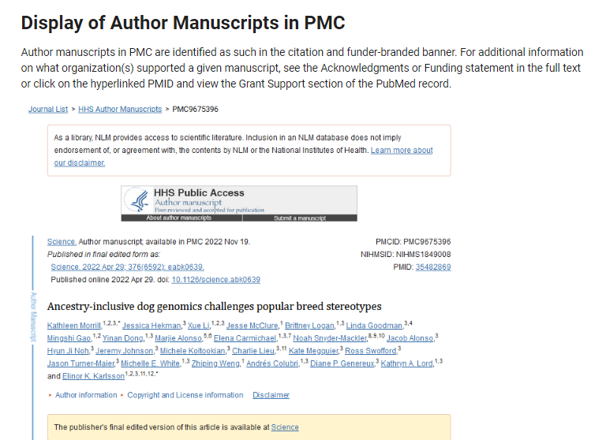

Slide 9
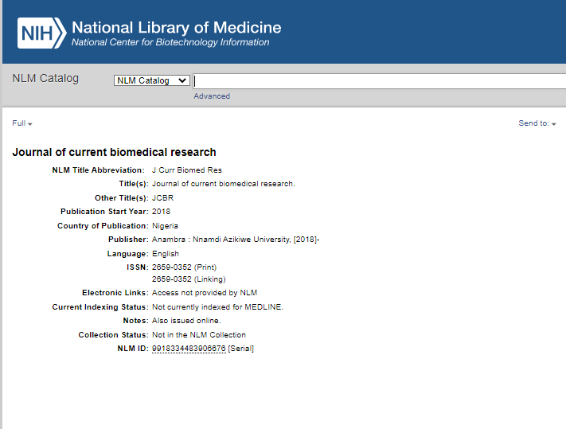

Slide 10

2. Using trusted local databases
http://rsf.research.ac.ir/

Slide 11
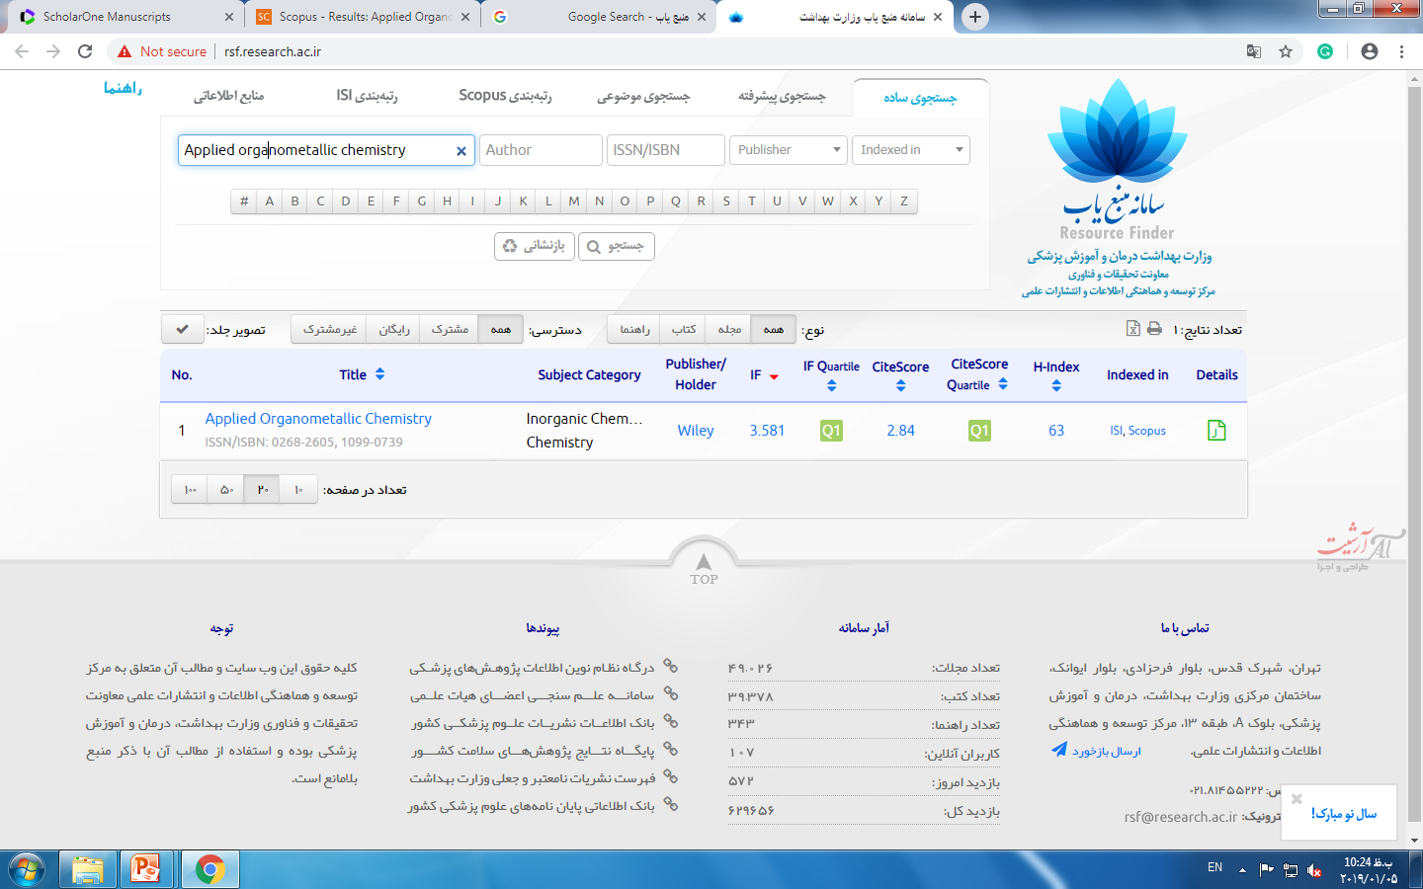
http://rsf.research.ac.ir/

Slide 12
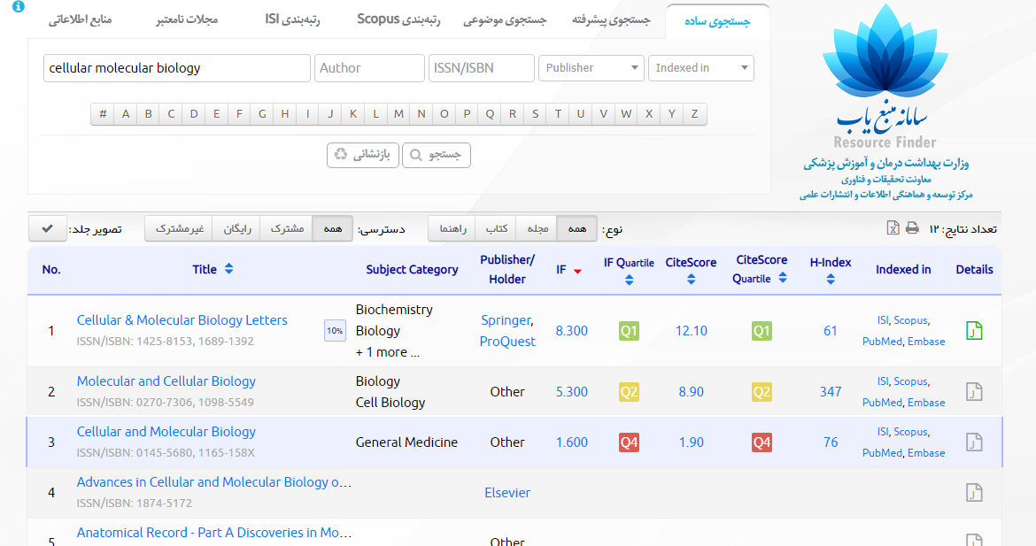
Importance of Having a Backup Solution!!!

Slide 13
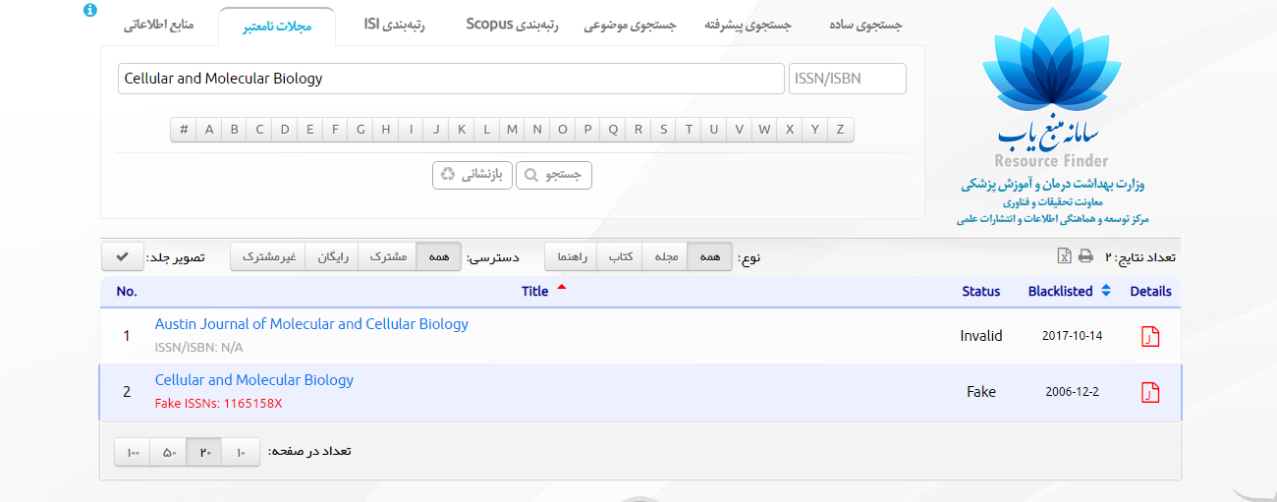
Importance of Having a Backup Solution!!!

Slide 14
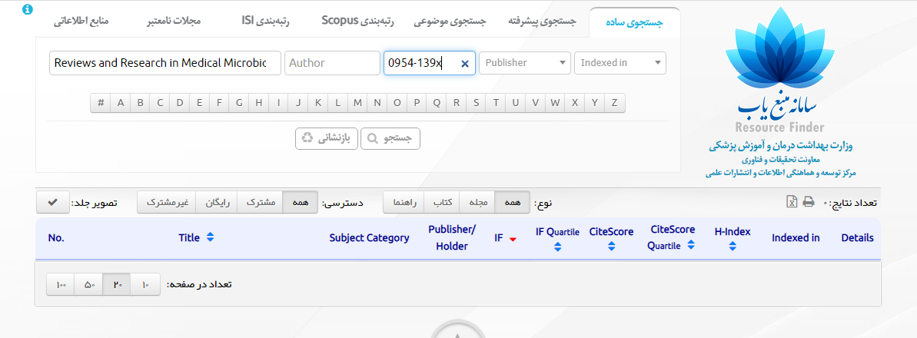
Importance of Having a Backup Solution!!!

Slide 15
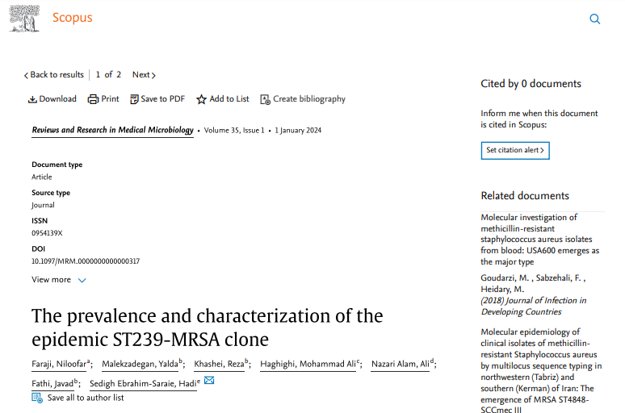
Importance of Having a Backup Solution!!!

Slide 16

3. Using the origin!

Slide 17
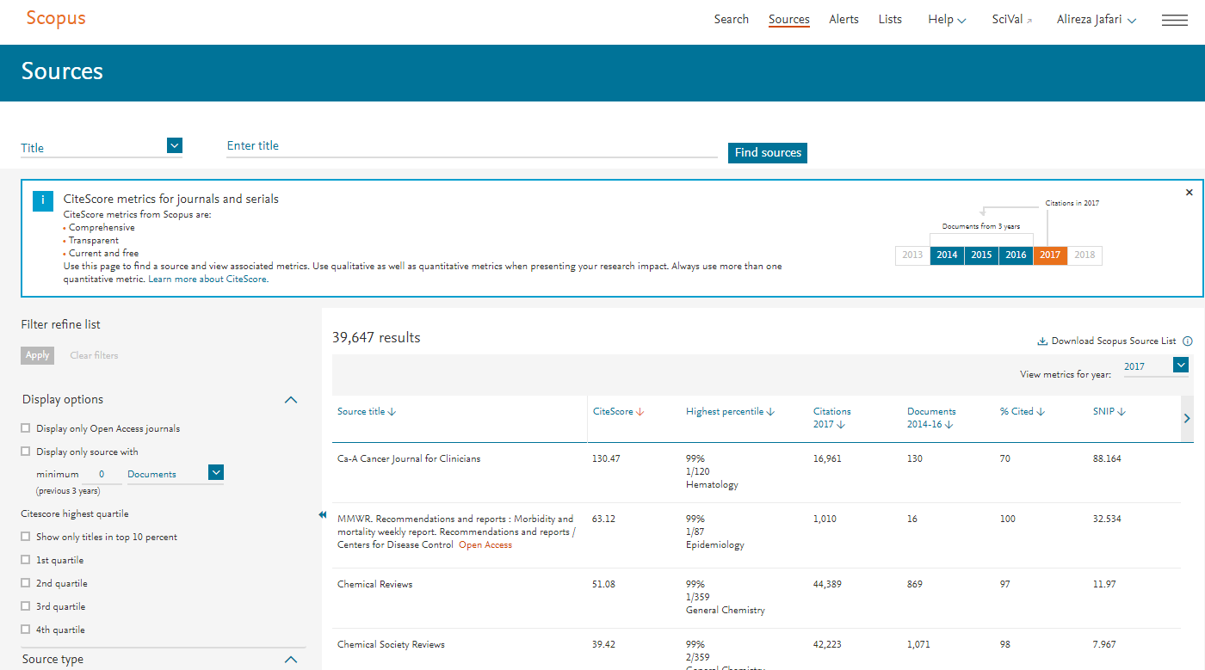

Slide 18
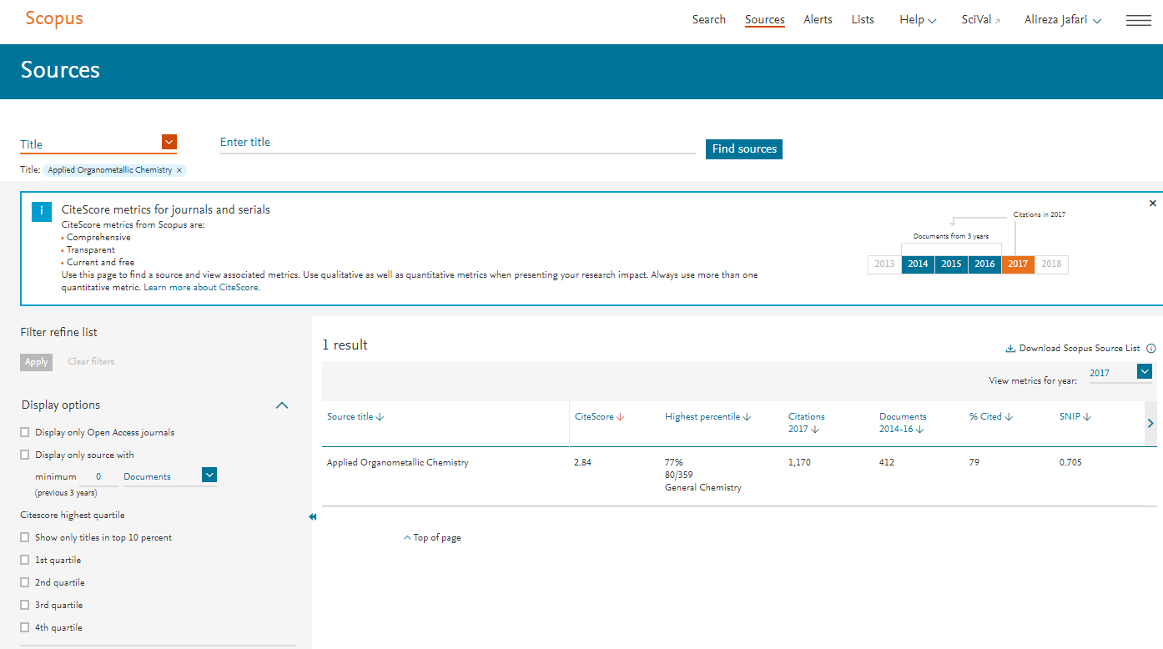

Slide 19
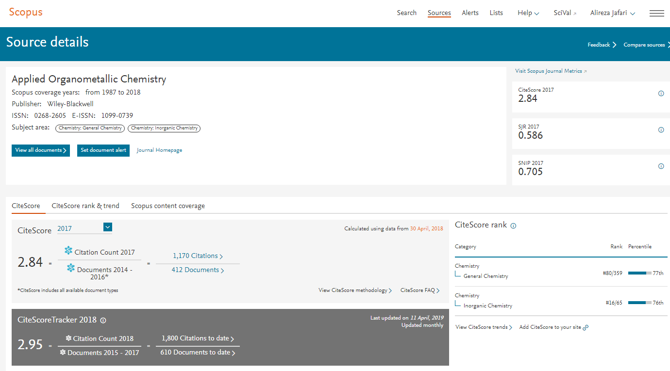

Slide 20
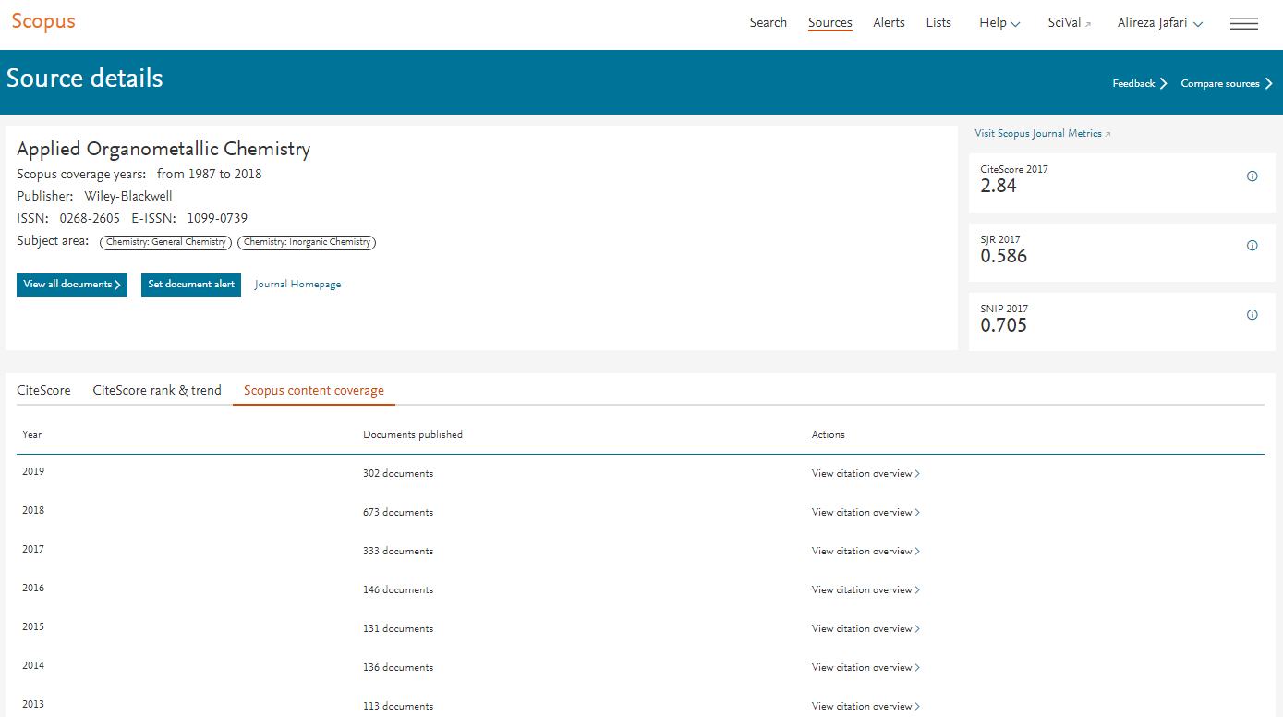

Slide 21
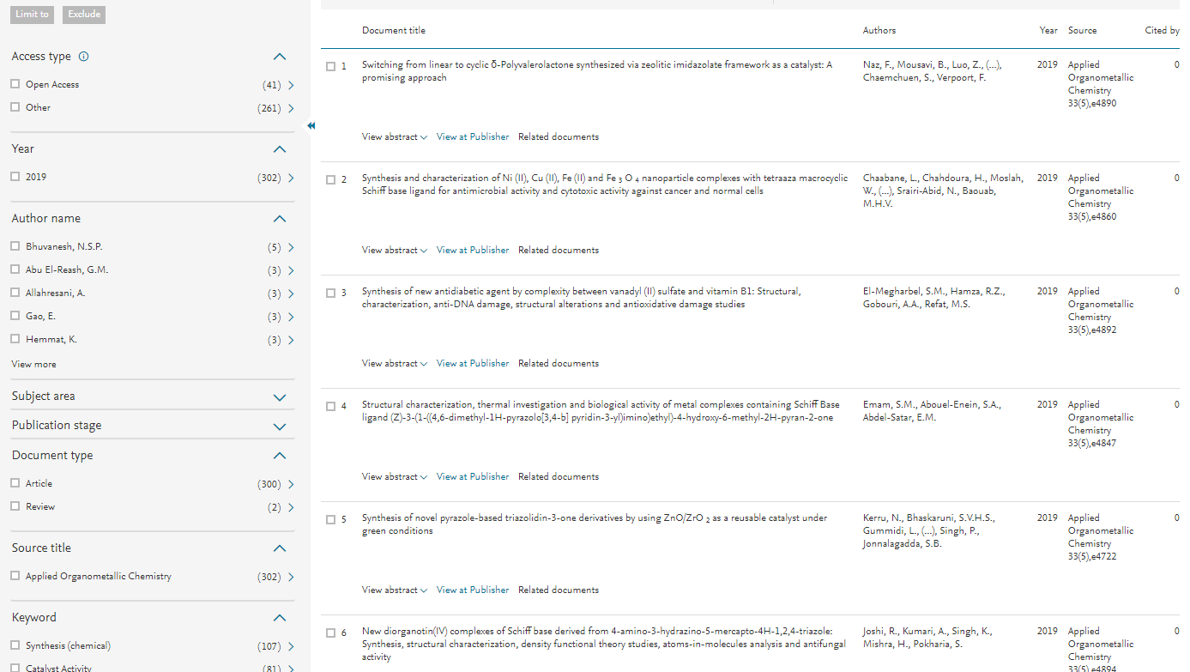

Slide 22
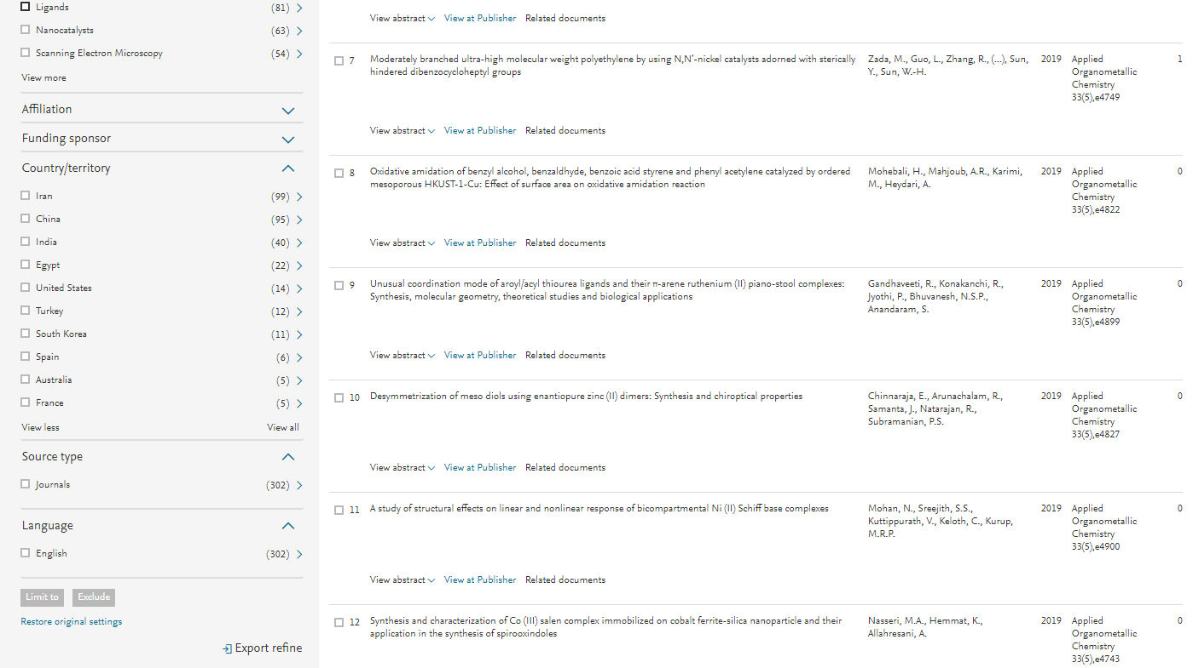

Slide 23

Web of Science [v.5.28] - Web of Science Core Collection Basic Search

Slide 24
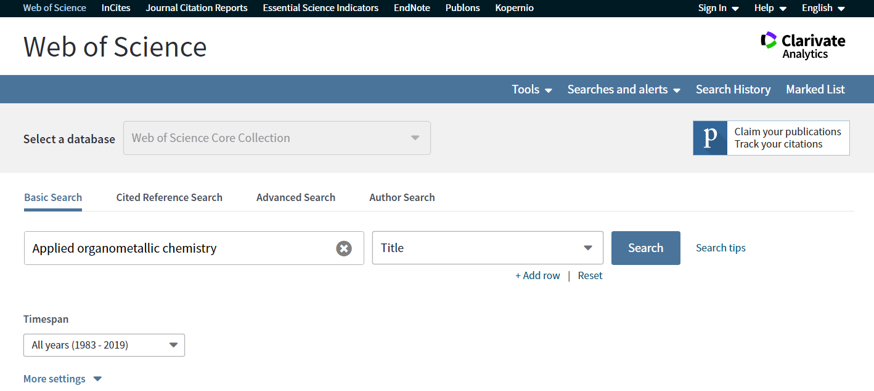

Slide 25
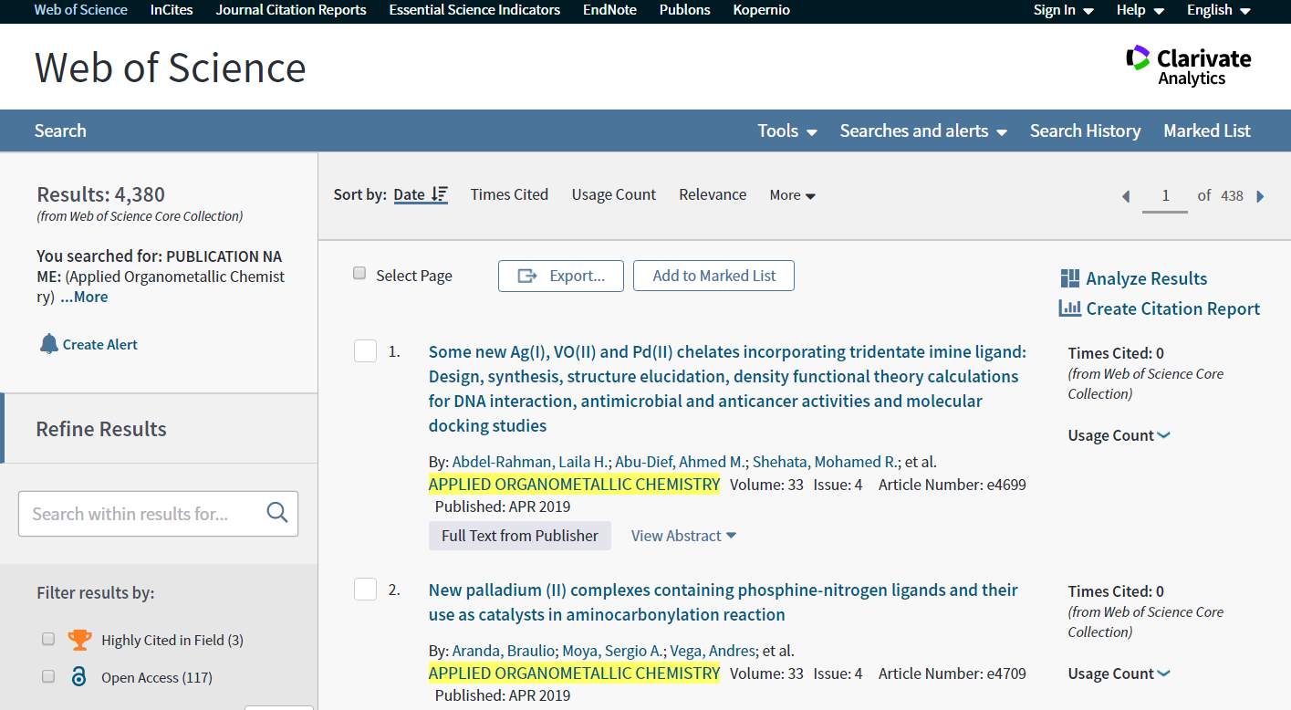

Slide 26
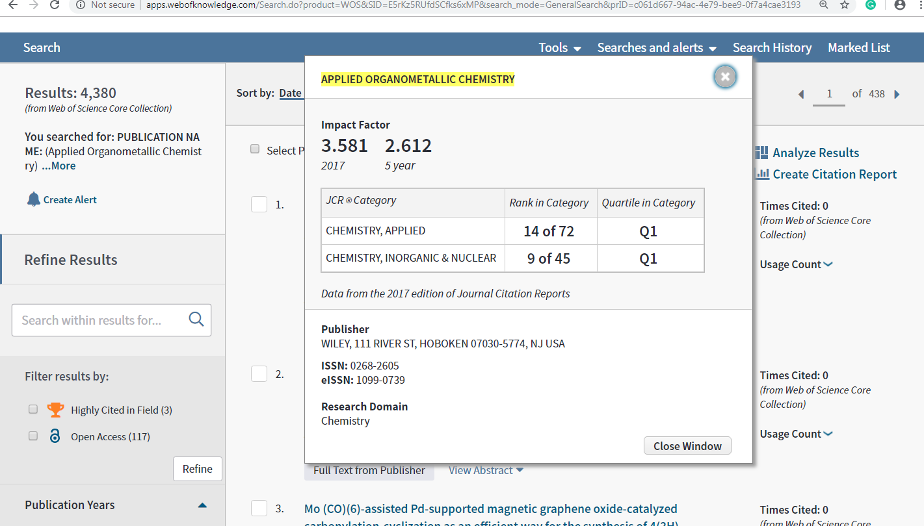

Slide 27


Slide 28
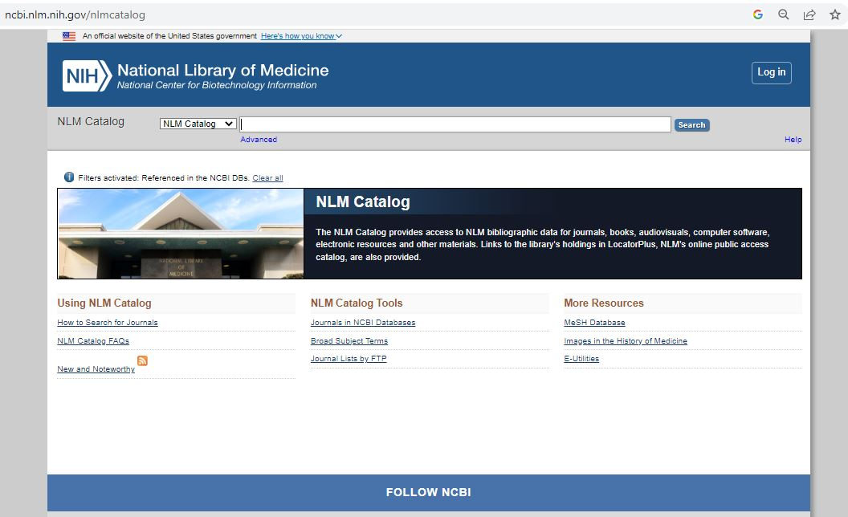

Slide 29
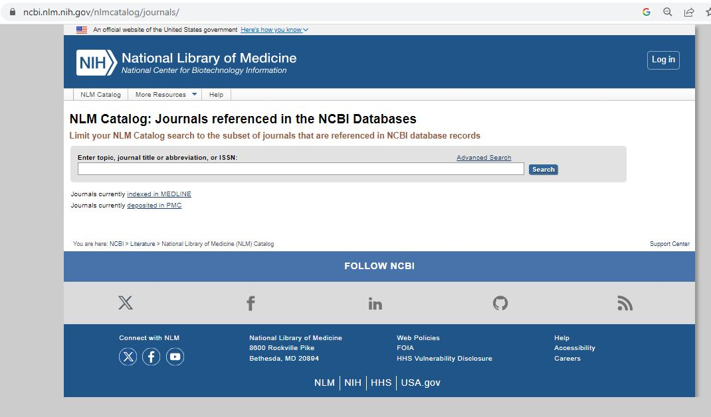

Slide 30
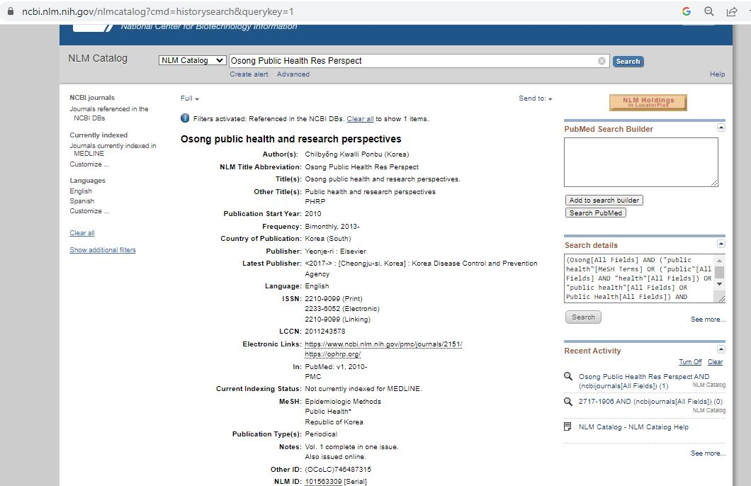

Slide 31
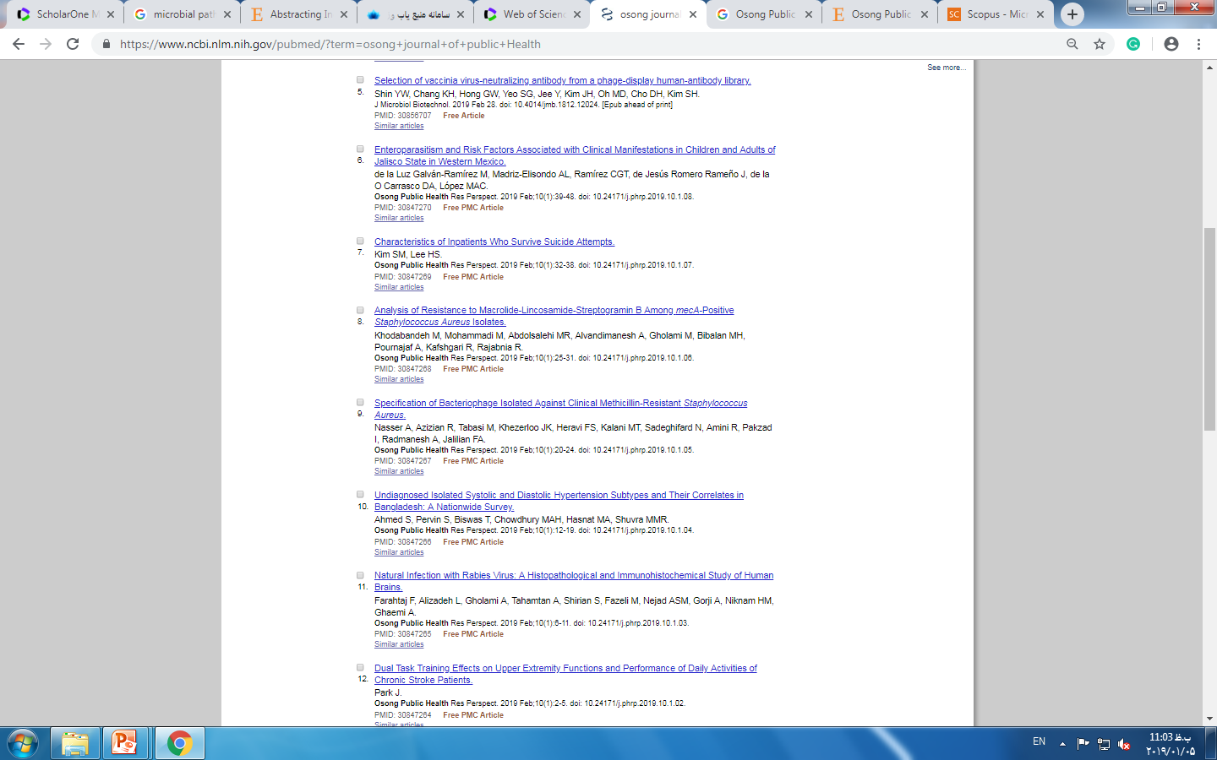
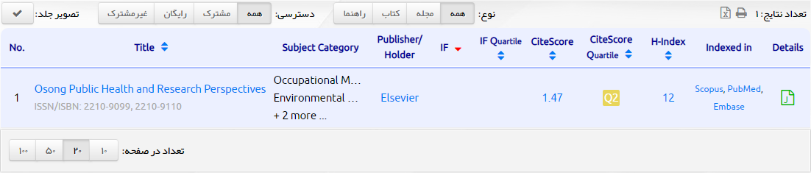
Osong Public Health and Research Perspectives

Slide 32




4. Predatory / Blacklisted Journals & Publishers

Slide 33
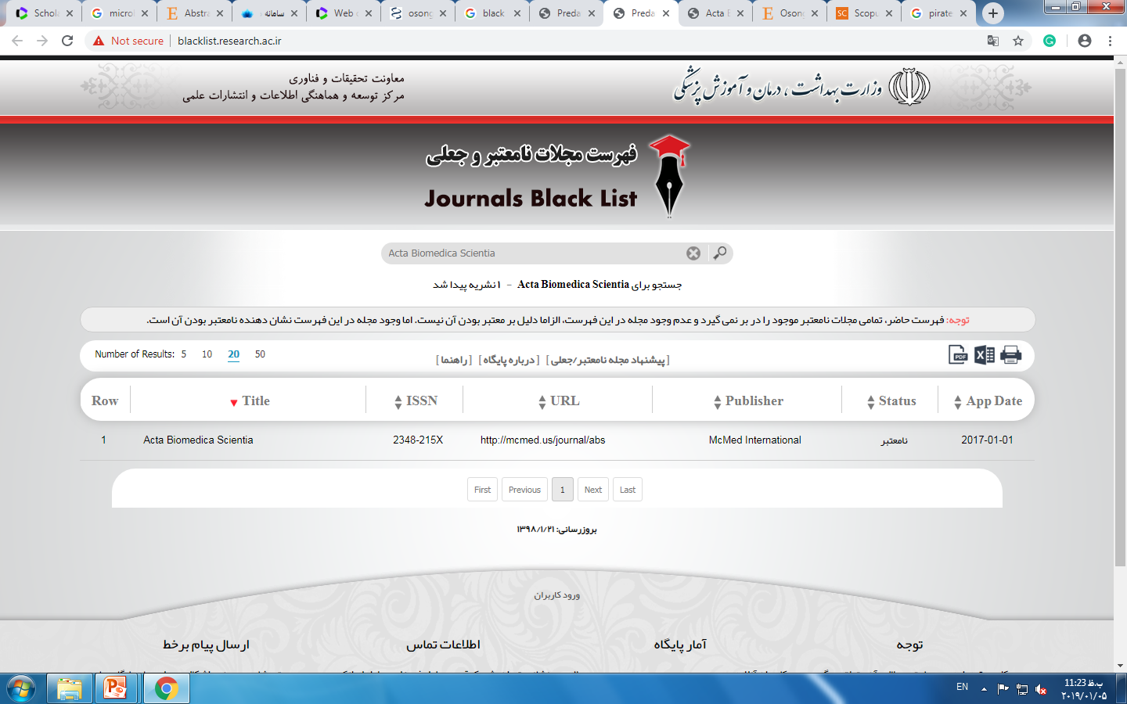
http://blacklist.research.ac.ir/
https://beallslist.net/

Slide 34
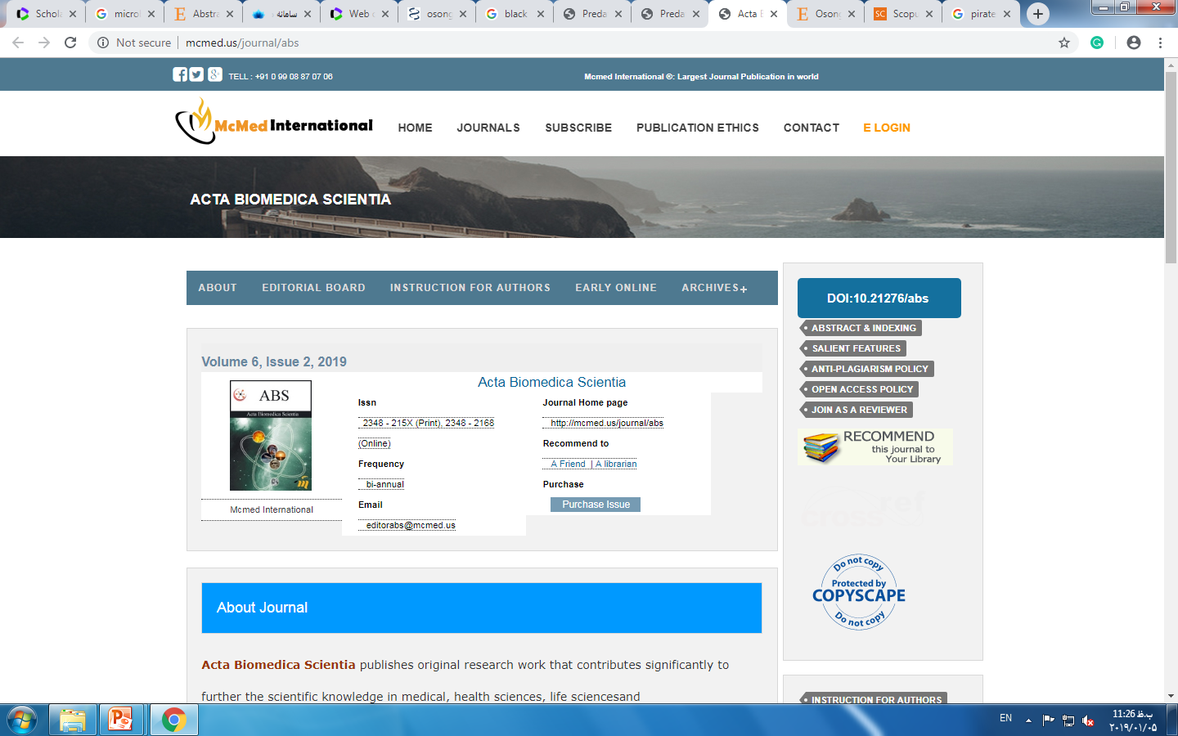

Slide 35
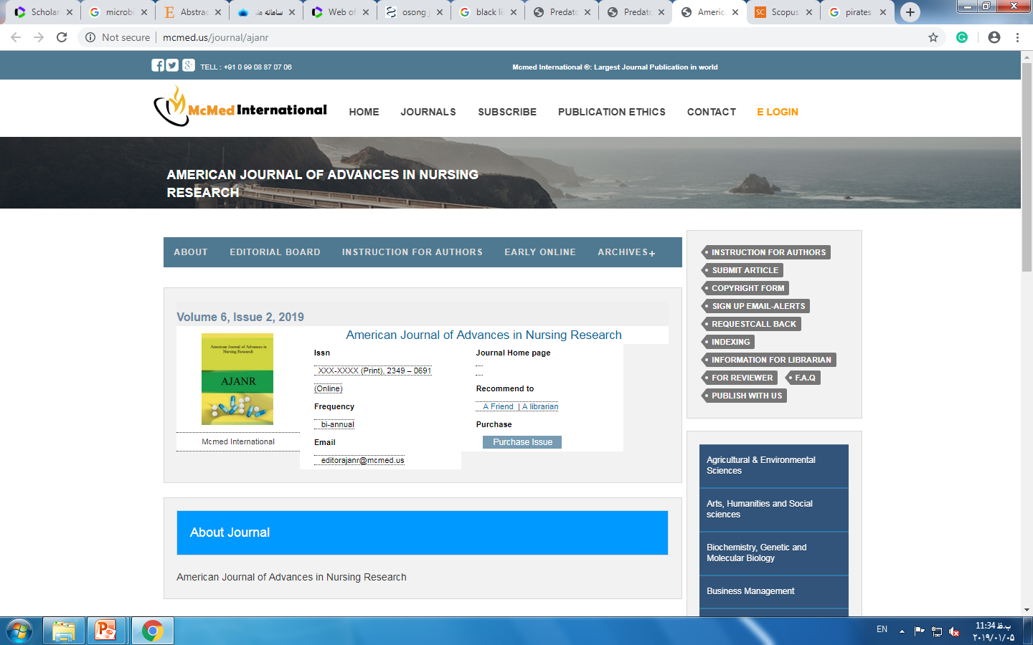

Slide 36
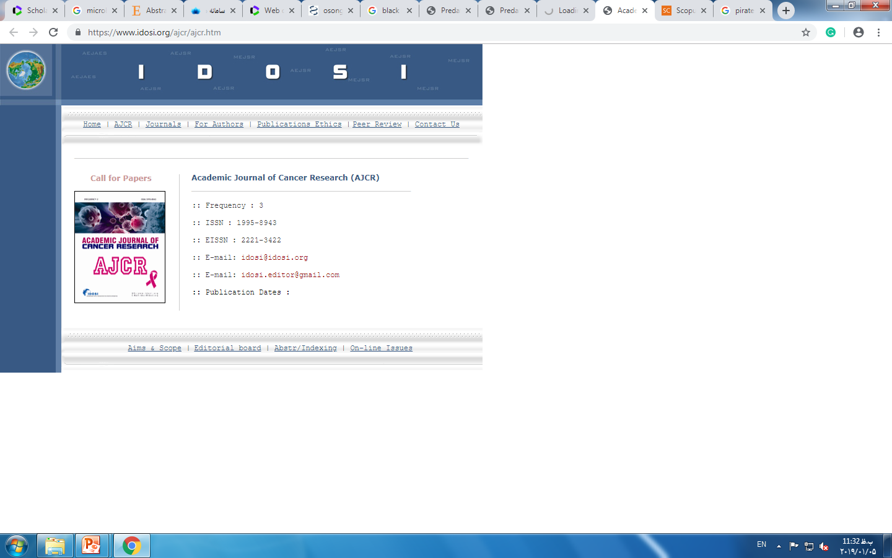

Slide 37
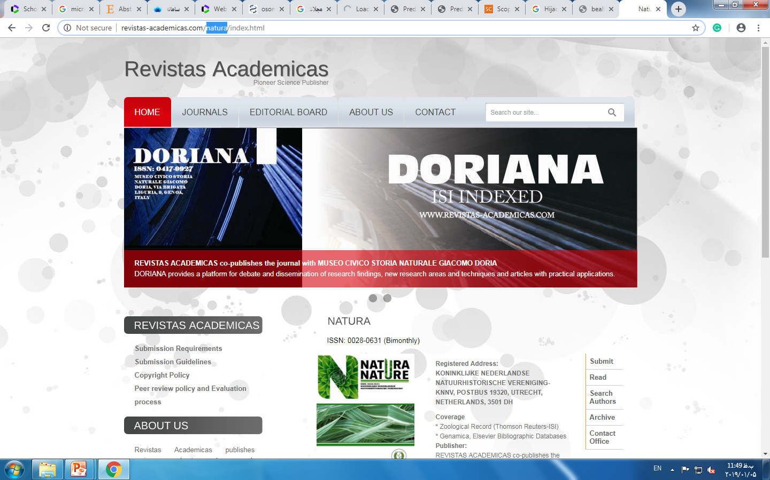

Slide 38
LOW QUALITY Indexes and
Unacceptable Indexes

Slide 39
Identifying a Target Journal
Decide early (before drafting the paper). Do not write the paper and then look for a journal.
Look for journals that have published work similar to yours.
Consider journals that have published work that you will cite.

Slide 40













LOW QUALITY Indexes

Slide 41









- The journal displays of non-standard indexing databases on the journal homepage, such as Eurasian Scientific Journal Index (ESJI), Directory of Research Journal Indexing (DRJI), International Scientific Indexing (ISI), Advanced Sciences Index (ASI), SJIFactor, ICI World of Journals, CiteFactor, Scientific Indexing Services (SIS), Journal Factor, Root Indexing. These types of ads are strongly discouraged.
Unacceptable Indexes

Slide 42
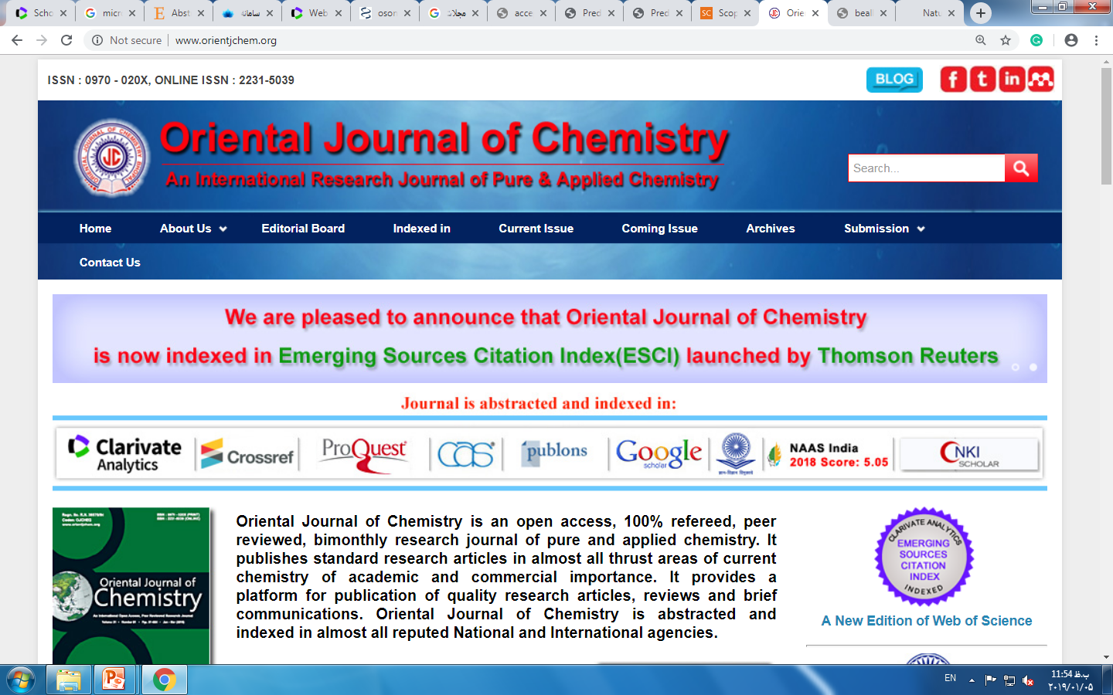
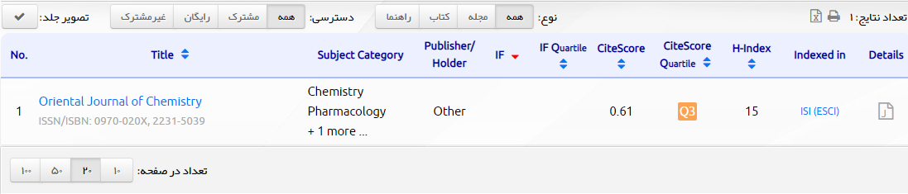
http://www.orientjchem.org/

Slide 43

How to Select a Journal for Research Paper Publication?

Slide 44
Quality of the work
Extent of the work
Interest to others

Slide 45

Seek guidance in this regard from others in your field who are more experienced in publishing journal articles.
Present your work orally first. Doing so can help in deciding whether the work is publishable and in shaping the paper.

Slide 46
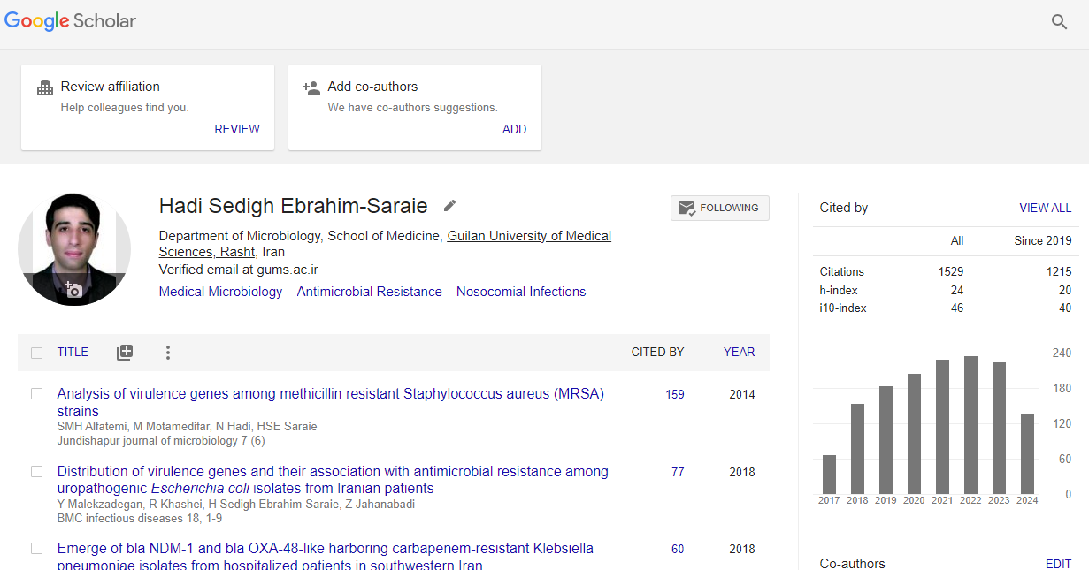
Google Scholar

Slide 47
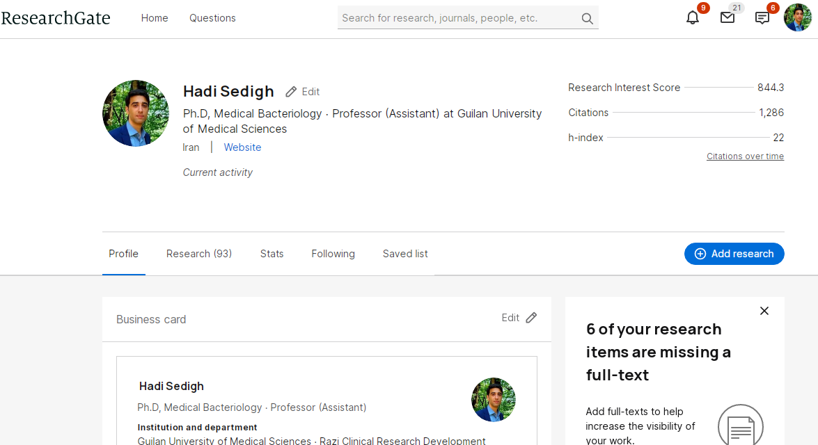

Slide 48
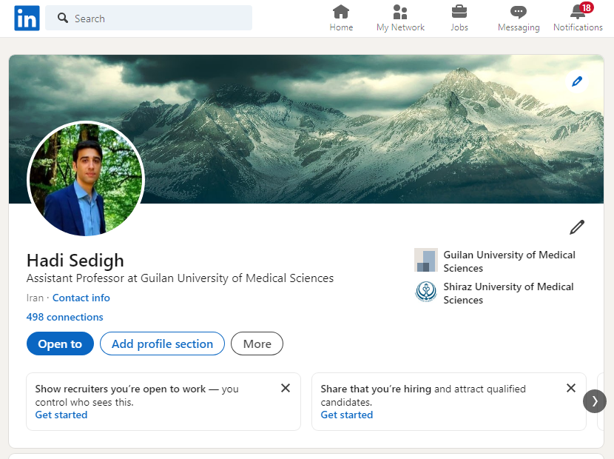

Slide 49
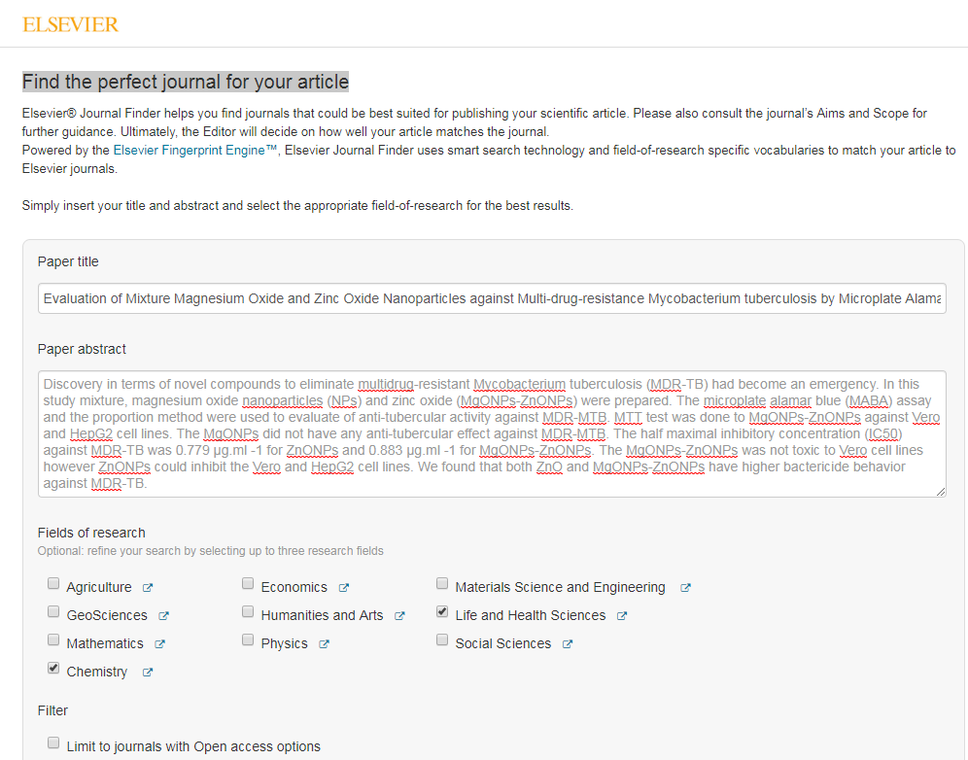
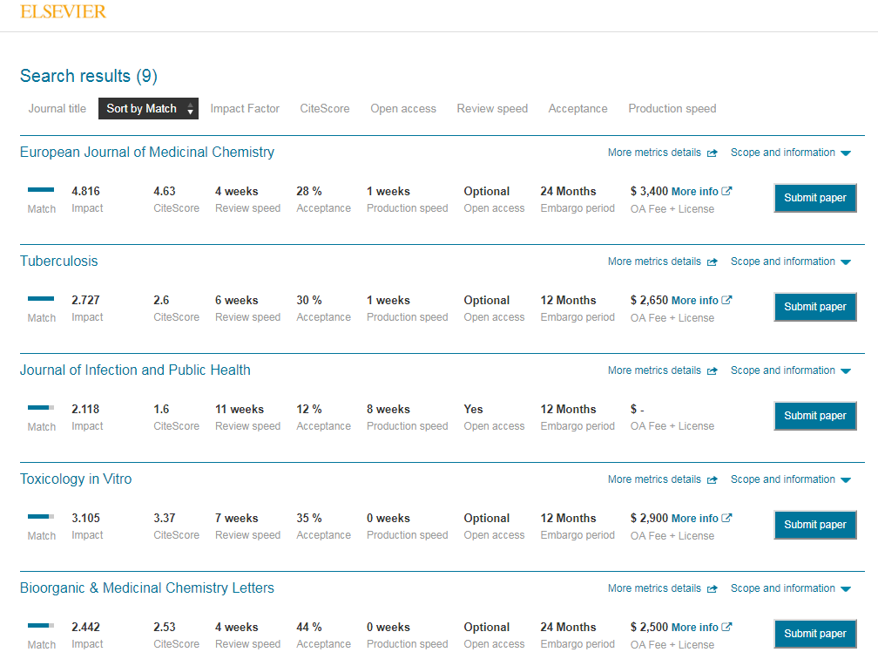
Journal Finders
https://journalfinder.elsevier.com/

Slide 50
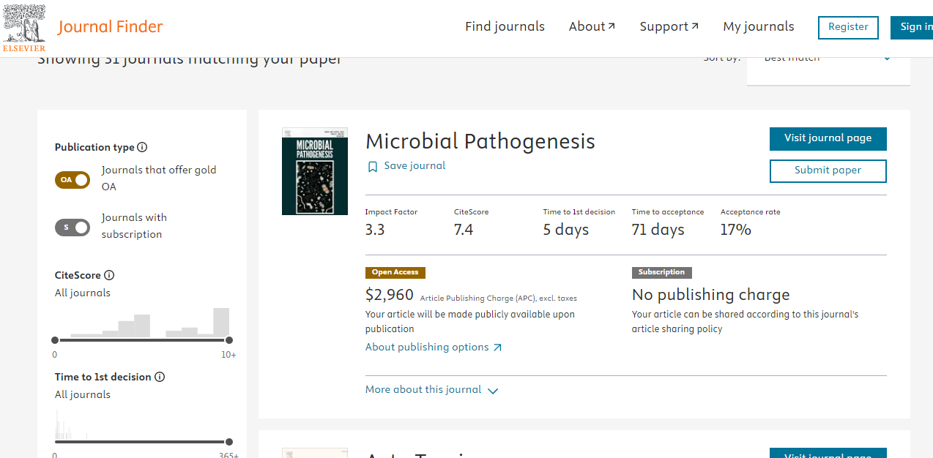
Journal Finders
https://journalfinder.elsevier.com/

Slide 51





Journal finders
https://journalfinder.elsevier.com/
https://journalsuggester.springer.com/
https://journalfinder.wiley.com/

Slide 52
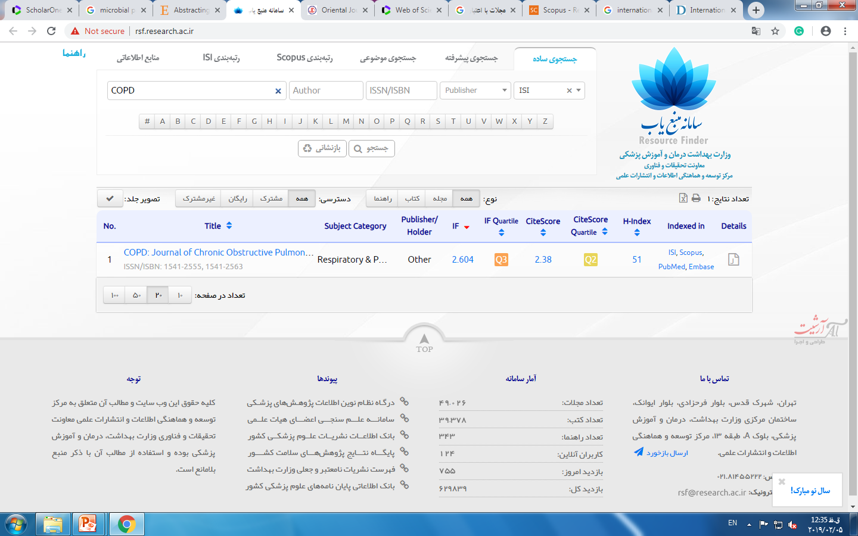
Selecting base on resource finder

Slide 53
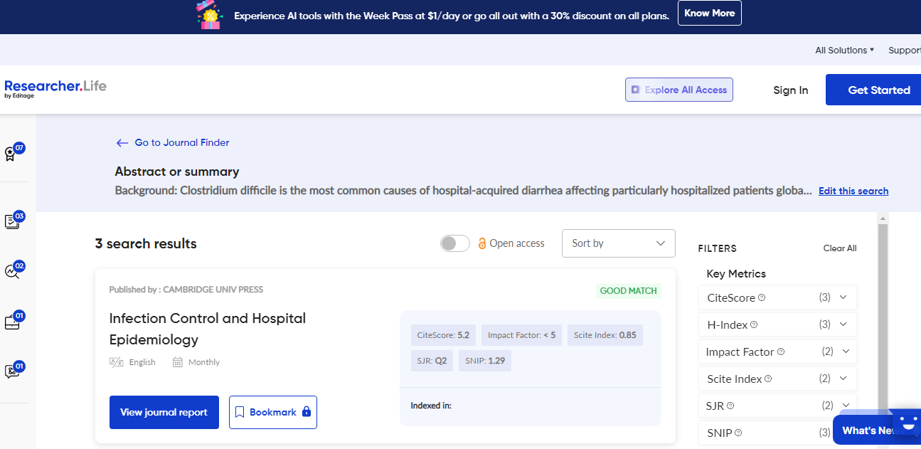

Slide 54
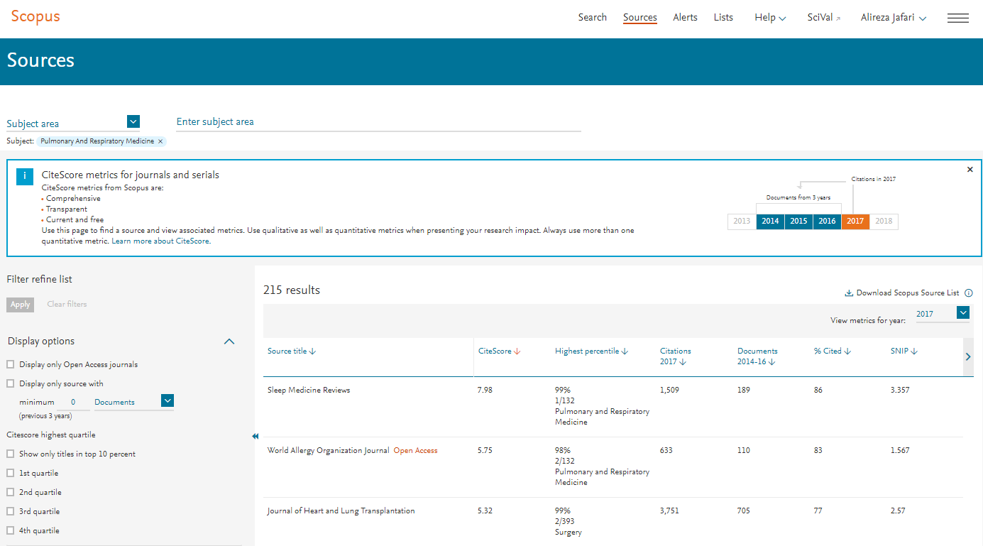
Selecting base on subject area

Slide 55
Selecting base on country and territory in Scopus
Applied Organometallic chemistry

Slide 56
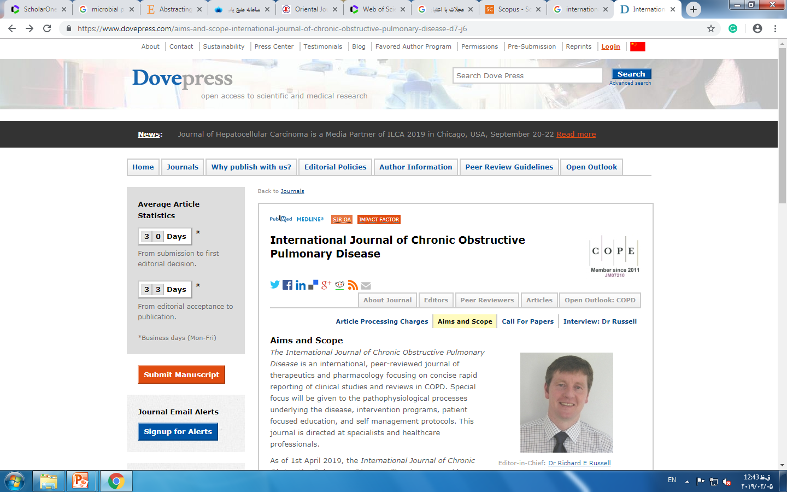
Selecting base on aim and scope of Journal

Slide 57
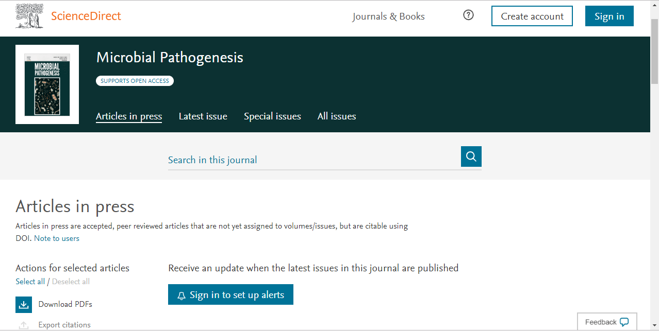
Selecting base on the interest of journal

Slide 58
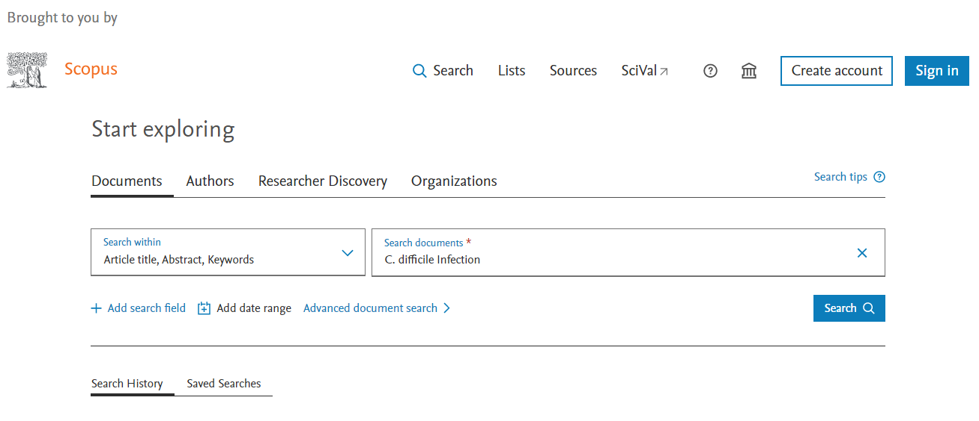
Journal findings by indexing database analysis tools

Slide 59
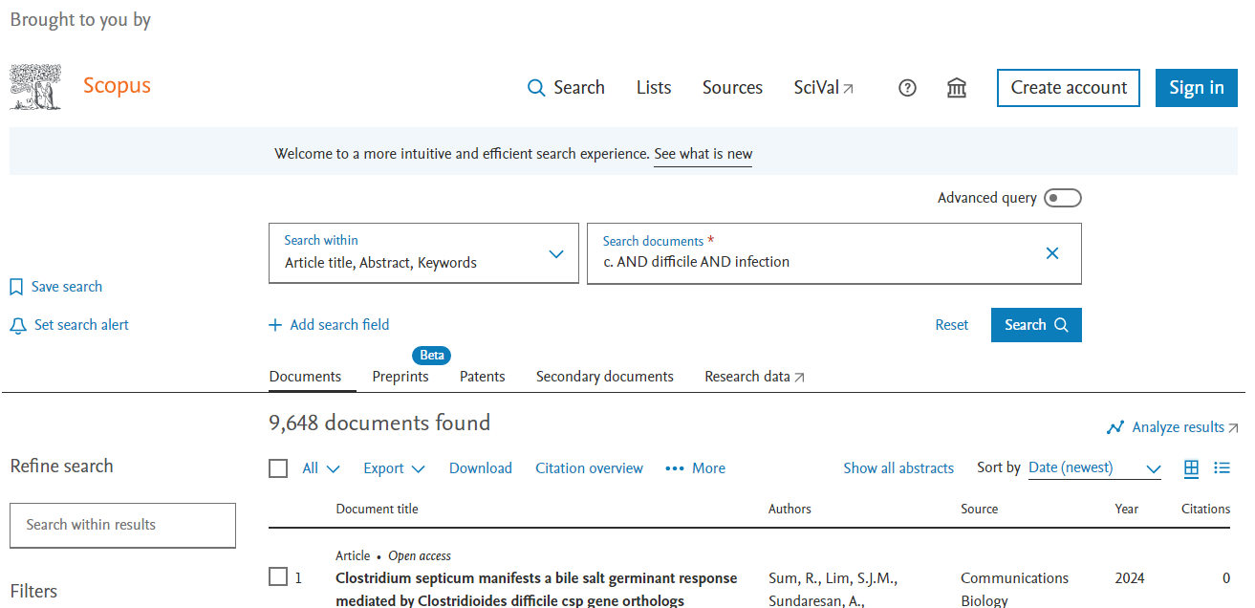
Journal findings by indexing database analysis tools

Slide 60
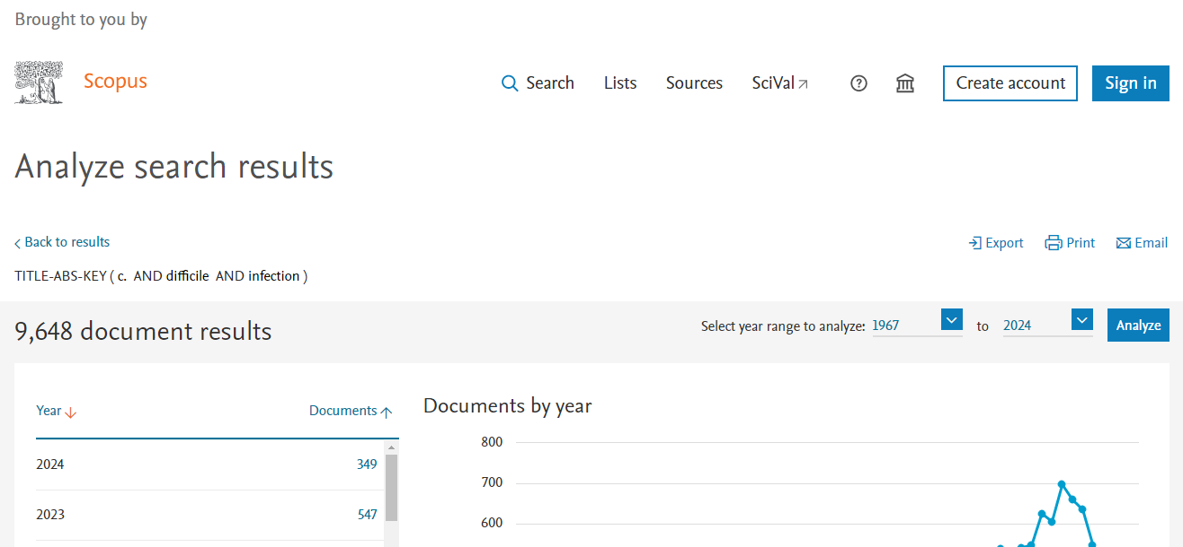
Journal findings by indexing database analysis tools

Slide 61
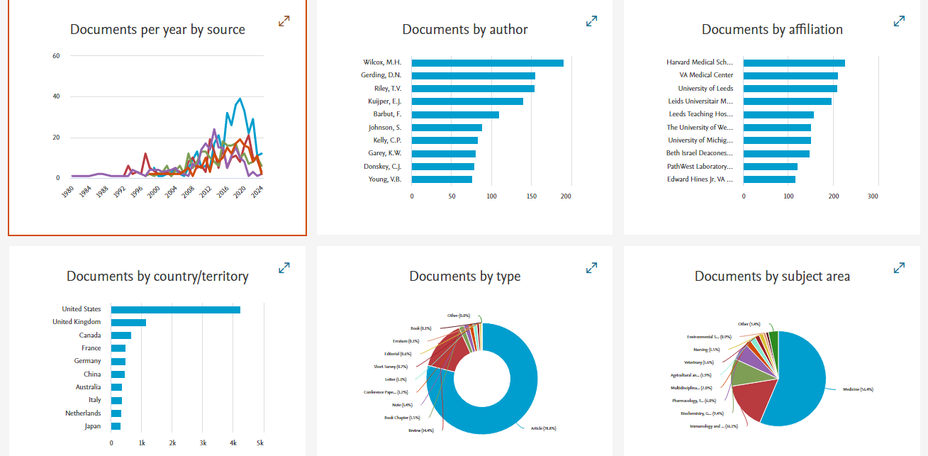
Journal findings by indexing database analysis tools

Slide 62
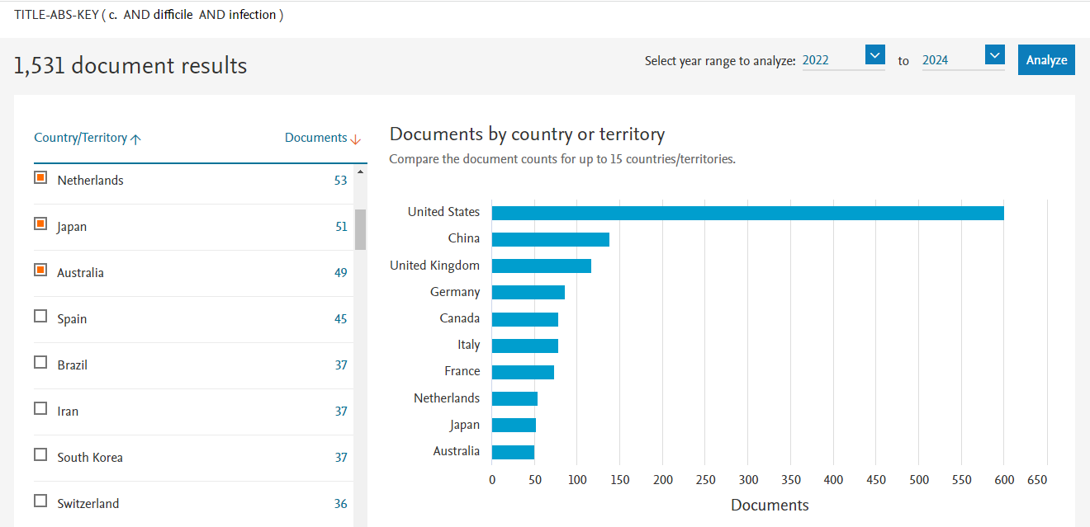
Journal findings by indexing database analysis tools

Slide 63
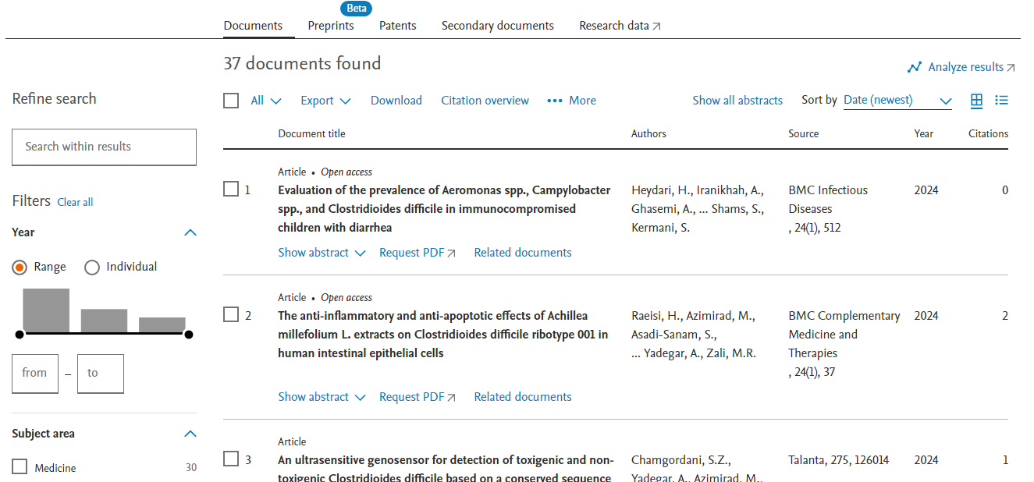
Journal findings by indexing database analysis tools

Slide 64
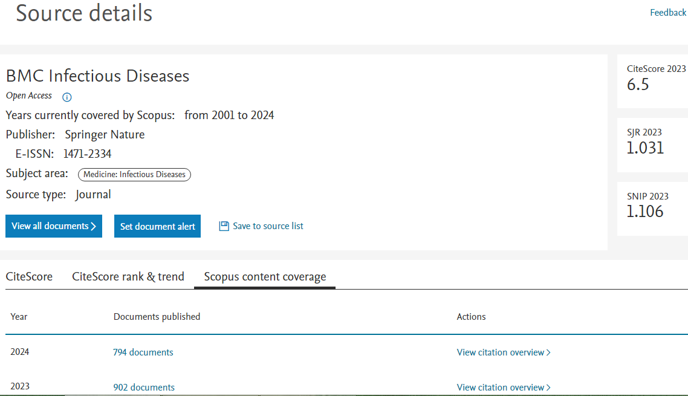
Journal findings by indexing database analysis tools

Slide 65
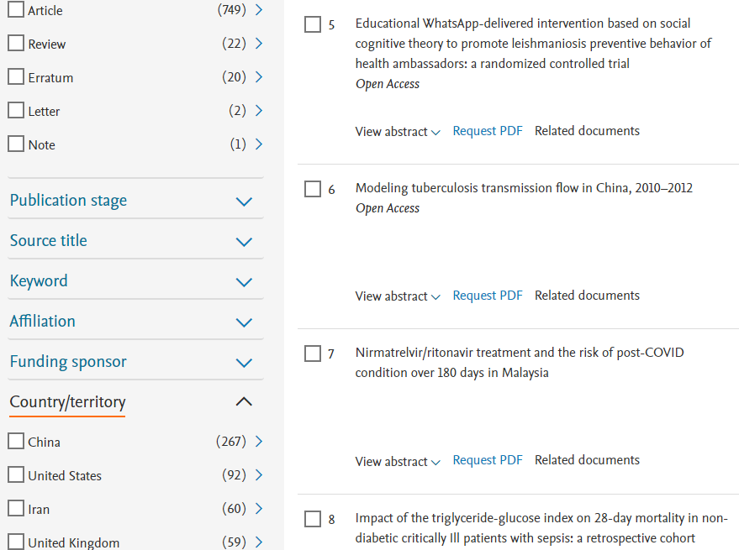
Journal findings by indexing database analysis tools

Slide 66

Chance: Last but not least!
کسي که گفته:
"ترجيح مي دهم خوش شانس باشم تا خوب"
نگاه عميقي به زندگي داشته!
Woody Allen

Slide 67

How do I write waiver request letter?

Slide 68

No. 11, Sardar Jangal Road,
Razi Hospital, Rasht, Iran
June 14, 2019
Dear Editor,
I am the corresponding author of this study entitled ”XXX". I am living in Iran, one of the upper-middle-income economies, and currently do not have any funding. Therefore, kindly request you to waive the fee for our article publishing charges. I look forward to hearing from you.
Best regards,
XXX, Ph.D.
Research Assistance Professor

Slide 69

How do I check plagiarism?

Slide 70

Plagiarism check

Slide 71

How do I write up cover letter?

Slide 72

No. 11, Sardar Jangal Road,
Razi Hospital, Rasht, Iran
29 January, 2019
Dear Editor,
This wrote to confirm the manuscript submission for consideration of publication in “XXX”. The manuscript is entitled “XXX”. The manuscript has not been submitted to another journal and will not be published elsewhere within one year after its publication in this journal. Publication in any reasonably retrievable source constitutes prior publication. Meeting abstracts or preprints do not constitute prior publication.
The subject of this paper is about:
Magnesium oxide nanoparticles (25 µg.ml ⁻¹, 20 nm) did not have any anti-tubercular effect against multi-drug-resistance Mycobacterium tuberculosis. Combined magnesium oxide and zinc oxide nanoparticles are useful to eliminate of multi-drug-resistance Mycobacterium tuberculosis. Zinc oxide nanoparticles showed toxic behavior against Vero and HepG2 cell lines.
This paper adds:
Mixing form of magnesium oxide and zinc oxide nanoparticles could eliminate clinical isolated multi-drug-resistance Mycobacterium tuberculosis with the lowest toxicity.
Summary sentence:
This work represents an advance in biomedical science because it shows that the mixture magnesium oxide and zinc oxide nanoparticles not only can inhibit growth of multi-drug-resistance Mycobacterium tuberculosis, but also could eliminate clinical isolated multi-drug-resistance Mycobacterium tuberculosis in vitro.
All authors concur with the submission and the manuscript does not contain experiments using animals. The manuscript also does not contain human studies.
Best regards,
XXX, Ph.D.
Research Assistance Professor

Slide 73

How do I write comment to Editor?

Slide 74

No. 11, Sardar Jangal Road,
Razi Hospital, Rasht, Iran
29 January, 2019
Dear Prof. XXX,
Authors of the present study have long research experiences in the inhibitory effect of metallic nanoparticles to of Mycobacterium tuberculosis into the infected macrophage, particularly anti-tubercular and intracellular effects of mixed silver and zinc oxide nanoparticle on TB infected human macrophages cell lines (THP-1). To date, several works of them on this field published and cited multiple times by other researchers. In the present article, authors with addressing to growing threat of TB and limited therapeutic option reviewed available articles to introducing new treatment approach by metallic nanoparticles of which inhibit Mtb/MDR-TB after phagocytosis into the phagolysosomes of macrophages.
Best regards,
XXX, Ph.D.
Research Assistance Professor

Slide 75
How to Increase the Chances of Getting Published?

Slide 76

Who is your superstar?
“The role of corresponding author reputation”

Slide 77







Social Media's Impact

Slide 78

Favorite scientific social media
https://researchgate.net
https://www.linkedin.com
https://scholar.google.com
http://orcid.org
https://www.scopus.com
https://www.academia.edu

Slide 79
Good Translating and Good English Language Editing

Slide 80

http://www.grammarly.com/

Slide 81


Becoming a recognized reviewer!
https://Publons.com
Owner: Clarivate Analytics

Slide 82

Becoming a recognized reviewer!

Slide 83


International co-authors

Slide 84




Know your place

Slide 85
How can score my paper?
Looking at the similar papers …
  But this is not everything you need!
Time of publication?
Where are they from?
Where are they performed the study? (Lack of data!?)
Similar sample size or studied population?
Similar methods?
The level of English writing?

Slide 86


What is the best choice?
Free or low price or even discount option!
Number of articles in each years?
Number of issue?
Number of aimed article type?
Geographical distribution?
Time from submission to first revision!?

Slide 87

Level of similarity

Slide 88


Slide 89


Attribute keywords

Slide 90

Title

Slide 91

Materials & Methods
Use appropriate ref wherever needed
Attention to wisely categorization (ordering, heading, etc.)
Copyright Compliance
Attention to ethical issue

Slide 92

Results presentation
Number of Table & Figure
Appropriate use of statistical analysis
Data presentation (Avoid repetition & excessive writing)
Figure resolution

Slide 93

Discussion
Introducing
Comparing (Only important results)
Limitations
Reasons!

Slide 94


Validity
Being up to date
Appropriate number
Formatting

Slide 95





Slide 96
Acknowledgment
This research was supported/partially supported by [Name of Foundation, Grant maker, Donor].
We thank our colleagues from [Name of the supporting institution] who provided insight and expertise that greatly assisted the research, although they may not agree with all of the interpretations/conclusions of this paper.
We thank [Name Surname, title] for assistance with [particular technique, methodology], and [Name Surname, position, institution name] for comments that greatly improved the manuscript.
We would also like to show our gratitude to the (Name Surname, title, institution) for sharing their pearls of wisdom with us during the course of this research, and we thank 3 “anonymous” reviewers for their so-called insights.
We are also immensely grateful to (List names and positions) for their comments on an earlier version of the manuscript, although any errors are our own and should not tarnish the reputations of these esteemed persons.

Slide 97




Slide 98


Author contribution

Slide 99

How do I contact with the Editor?

Slide 100

Guilan University of Medical Sciences
No. 11, Sardar Jangal Road,
Razi Hospital, Rasht, Iran.
April 30, 2019
Dear XXX,
I have sent the article (manuscript number: XXX) entitled “XXX" at 30-Jan-2019; however, still, I have not received your final decision. I would be appreciated if you let me know about the current status of my article.
King Regards,
XXX, Ph.D.
Research Assistance Professor

